Slide 1
Mobile Radio Propagation
Large-Scale Path Loss

Slide 2
Introduction
Radio wave propagation describes how electromagnetic (EM) waves travel from a transmitting antenna to a receiving antenna through space and the environment.
In mobile communication systems, propagation is influenced by:
Distance between transmitter and receiver (T-R separation)
Terrain and environment (urban, suburban, rural)
Frequency of operation
Antenna heights and characteristics
Presence of obstacles (buildings, trees, terrain)
Large-scale propagation focuses on average signal power over large distances (hundreds to thousands of wavelengths), ignoring rapid fluctuations caused by multipath.

Slide 3
Large-Scale Path Loss
Path loss is the reduction in signal power as a radio wave propagates through space.
Causes of Path Loss
Geometric spreading of the wave
Absorption by the atmosphere
Reflection, diffraction, and scattering by obstacles
Large-scale path loss models predict mean received signal strength and are critical for:
Cell coverage planning
Base station placement
Link budget analysis

Slide 4
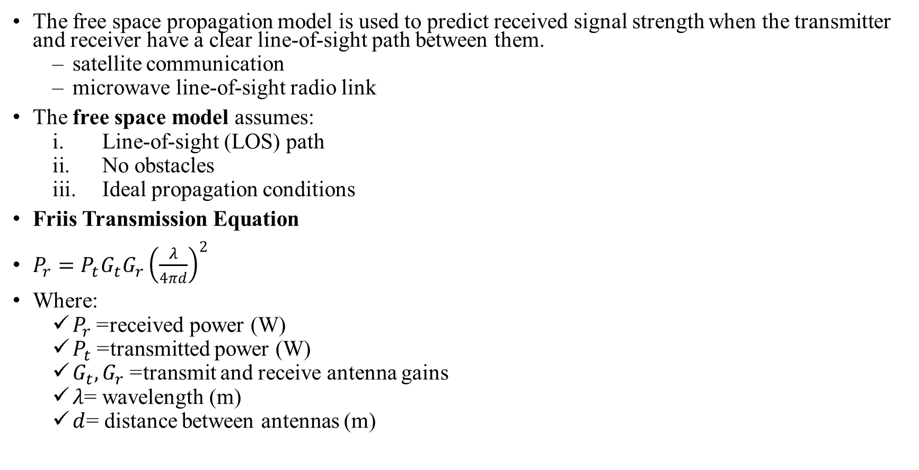
Free Space Propagation Model
The free space propagation model is used to predict received signal strength when the transmitter and receiver have a clear line-of-sight path between them.
satellite communication
microwave line-of-sight radio link
The free space model assumes:
Line-of-sight (LOS) path
No obstacles
Ideal propagation conditions
Friis Transmission Equation
$P_{r}=P_{t}G_{t}G_{r}{\left(\frac{λ}{4πd}\right)}^{2}$
Where:
$P_{r}$= received power (W)
$P_{t}$= transmitted power (W)
$G_{t},G_{r}$= transmit and receive antenna gains
$λ$= wavelength (m)
$d$= distance between antennas (m)

Slide 5
The gain of the antenna
: effective aperture is related to the physical size of the antenna
The wave length is related to the carrier frequency by
: carrier frequency in Hertz
: carrier frequency in radians
: speed of light (meters/s)
The losses are usually due to transmission line attenuation, filter losses, and antenna losses in the communication system. A value of L=1 indicates no loss in the system hardware.

Slide 6
Isotropic radiator is an ideal antenna which radiates power with unit gain.
Effective isotropic radiated power (EIRP) is defined as
and represents the maximum radiated power available from transmitter in the direction of maximum antenna gain as compared to an isotropic radiator.
Path loss for the free space model with antenna gains
When antenna gains are excluded
The Friis free space model is only a valid predictor for for values of d which is in the far-field (Fraunhofer region) of the transmission antenna.

Slide 7
The far-field region of a transmitting antenna is defined as the region beyond the far-field distance
where D is the largest physical linear dimension of the antenna.
To be in the far-filed region the following equations must be satisfied
and
Furthermore the following equation does not hold for d=0.
Use close-in distance and a known received power at that point
or

Slide 8
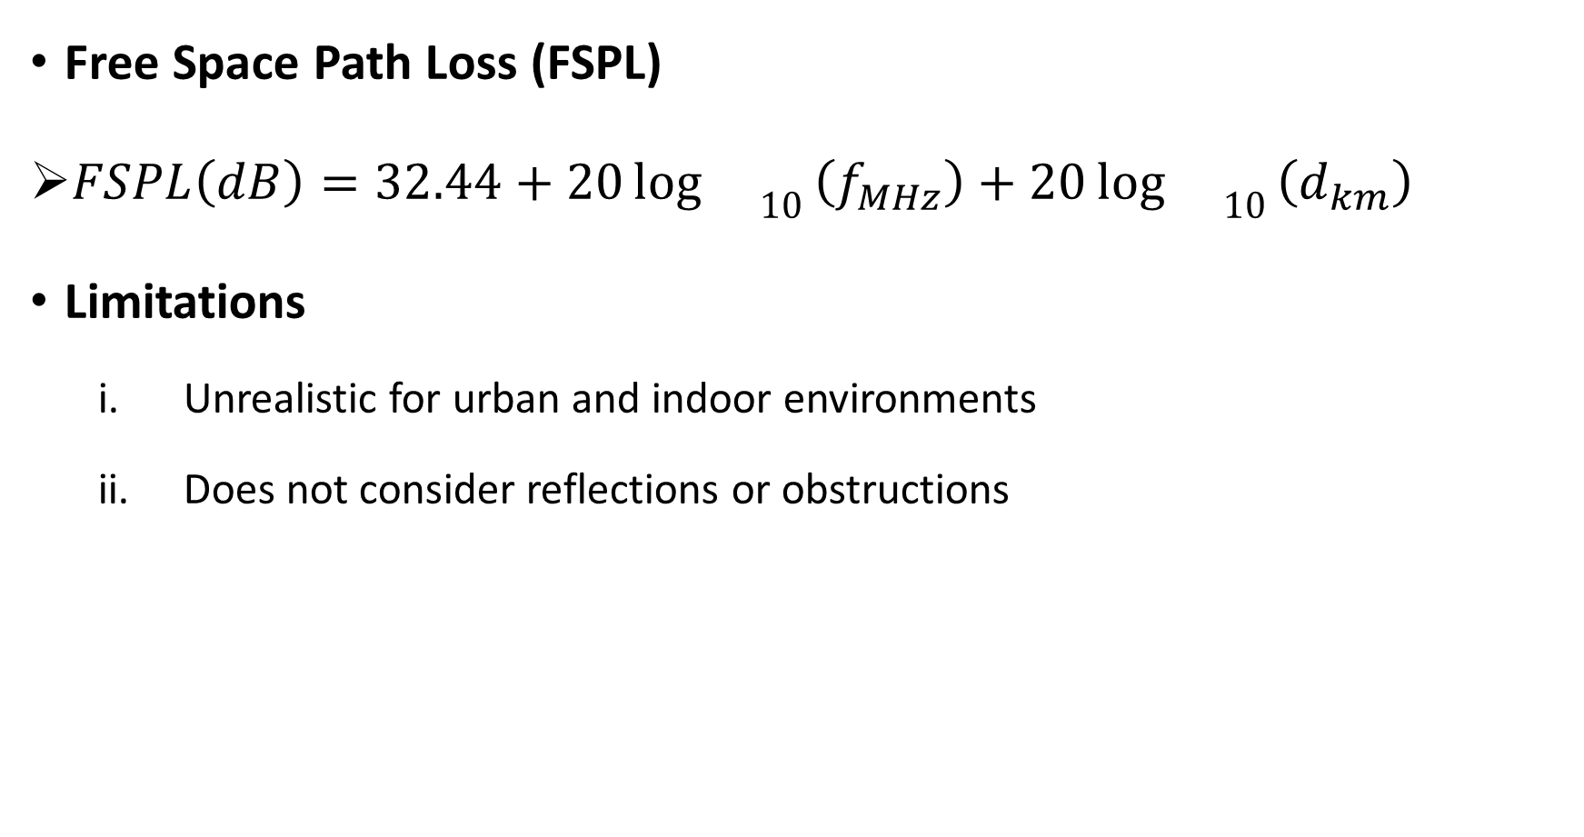
Free Space Path Loss (FSPL)
$FSPL\left(dB\right)=32.44+20{\log{}}_{10}\left(f_{MHz}\right)+20{\log{}}_{10}\left(d_{km}\right)$
Limitations
Unrealistic for urban and indoor environments
Does not consider reflections or obstructions

Slide 9
Example 1
A base station transmits 20 W at a frequency of 900 MHz. The receiver is located 5 km away. Both antennas have 0 dBi gain. Find:
Free Space Path Loss
Received power in dBm

Slide 10

solution
Step 1: Free Space Path Loss
$FSPL\left(dB\right)=32.44+20{\log{}}_{10}\left(f_{MHz}\right)+20{\log{}}_{10}\left(d_{km}\right)$
$FSPL=32.44+20{\log{}}_{10}\left(900\right)+20{\log{}}_{10}\left(5\right)$
$FSPL=32.44+59.08+13.98=\boxed{105.5 dB}$
Step 2: Convert Transmit Power to dBm
$P_{t}\left(dBm\right)=10{\log{}}_{10}\left(20000\right)=\boxed{43 dBm}$
Step 3: Received Power
$P_{r}=P_{t}+G_{t}+G_{r}−FSPL$
$P_{r}=43+0+0−105.5=\boxed{−62.5 dBm}$

Slide 11
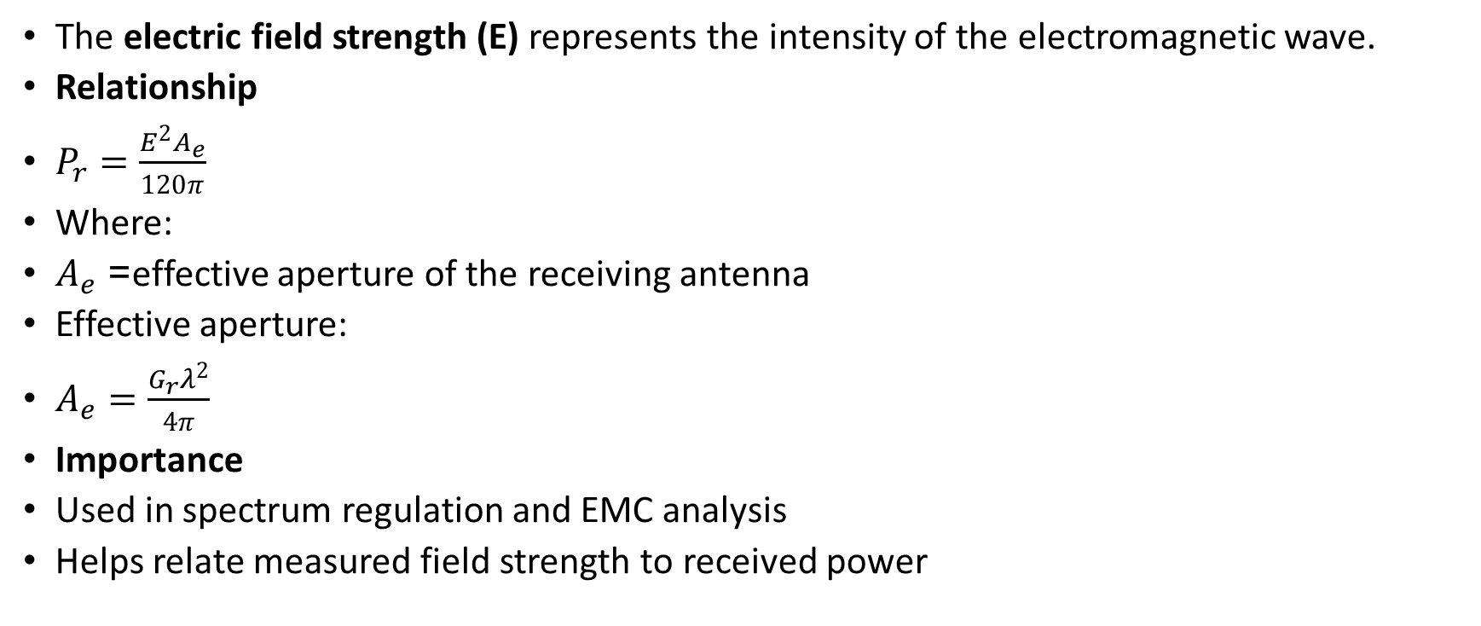
Relating Power to Electric Field Strength
The electric field strength (E) represents the intensity of the electromagnetic wave.
Relationship
$P_{r}=\frac{E^{2}A_{e}}{120π}$
Where:
$A_{e}$= effective aperture of the receiving antenna
Effective aperture:
$A_{e}=\frac{G_{r}λ^{2}}{4π}$
Importance
Used in spectrum regulation and EMC analysis
Helps relate measured field strength to received power

Slide 12
Basic Propagation Mechanisms
The three basic propagation mechanisms are:
Reflection
Diffraction
Scattering

Slide 13
Reflection
Reflection occurs when a propagating electromagnetic wave impinges upon an object which has very large dimensions when compared to the wavelength, e.g., buildings, walls.
Common in urban environments
Causes multipath propagation
Reflection coefficient depends on material and angle of incidence

Slide 14
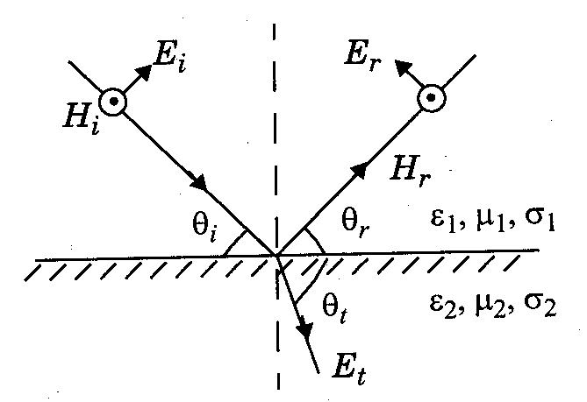
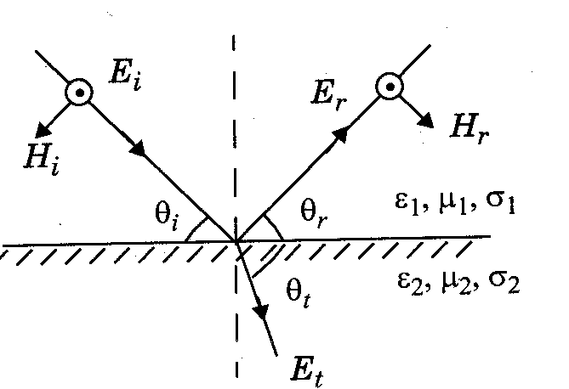
Reflection from dielectrics
Reflection from perfect conductors
E-field in the plane of incidence
E-field normal to the plane of incidence

Slide 15
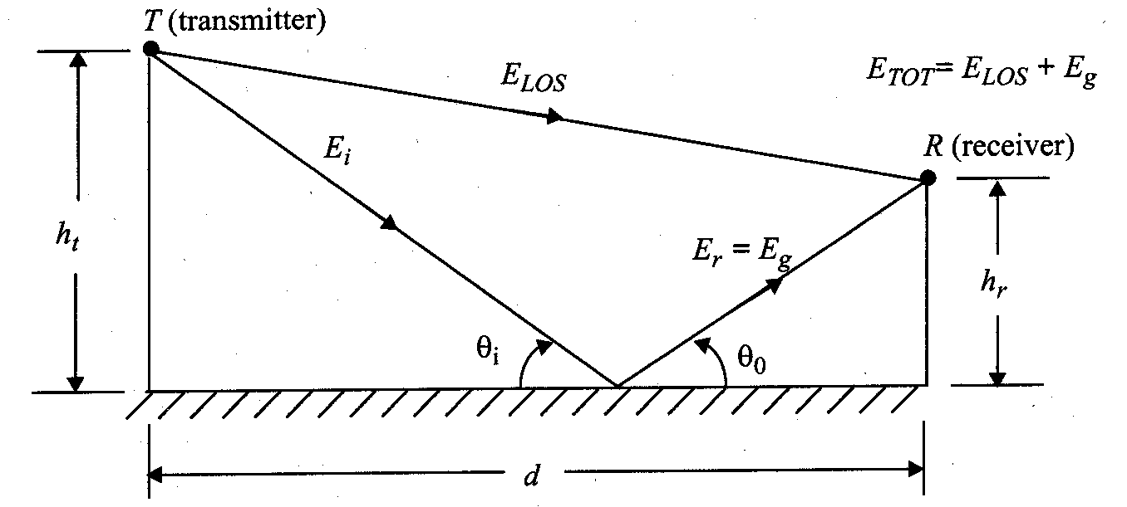
Ground Reflection (2-ray) Model

Slide 16
Diffraction
Diffraction occurs when the radio path between the transmitter and receiver is obstructed by a surface that has sharp edges.
Enables communication beyond line-of-sight
Strongly influenced by obstacle geometry
Described using knife-edge diffraction models
Diffraction loss increases as obstruction height increases.

Slide 17
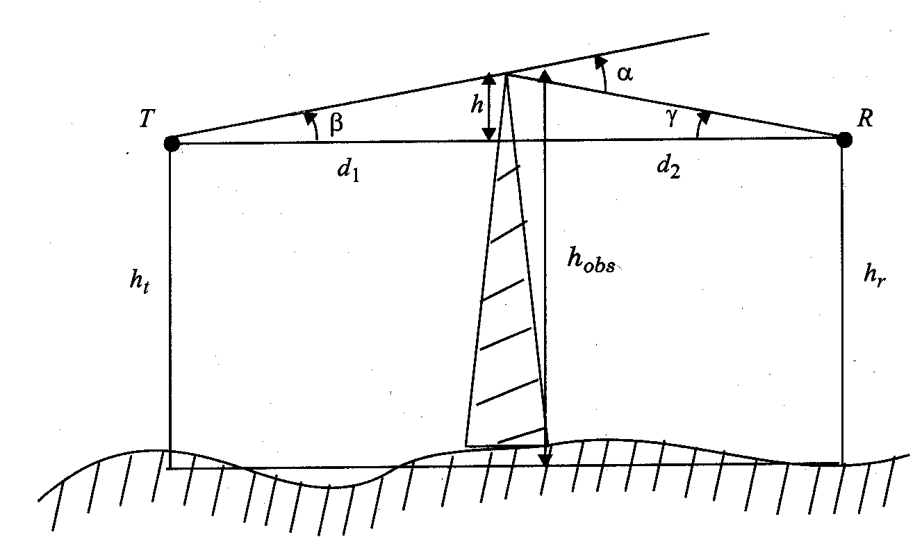
Diffraction

Slide 18
Scattering
Scattering occurs when the medium through which the wave travels consists of objects with dimensions that are small compared to the wavelength.
Occurs when waves hit objects smaller than the wavelength (e.g., foliage, street signs).
Dominant at higher frequencies
Causes signal energy to spread in many directions
Leads to rapid fluctuations in received signal

Slide 19
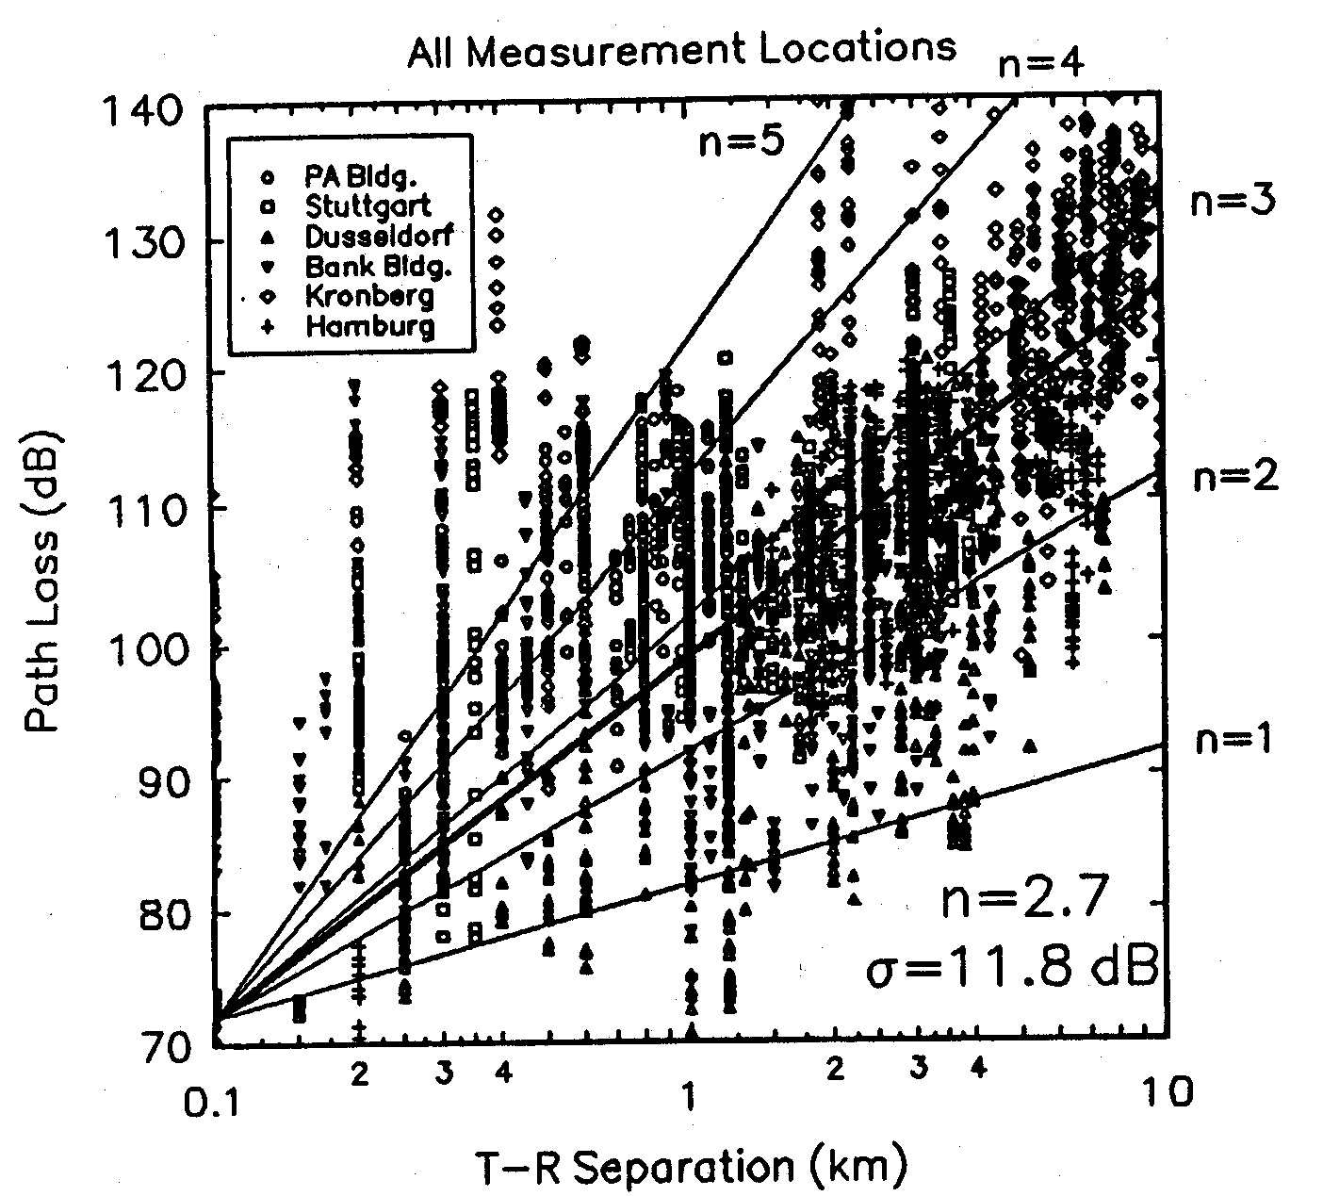

Slide 20
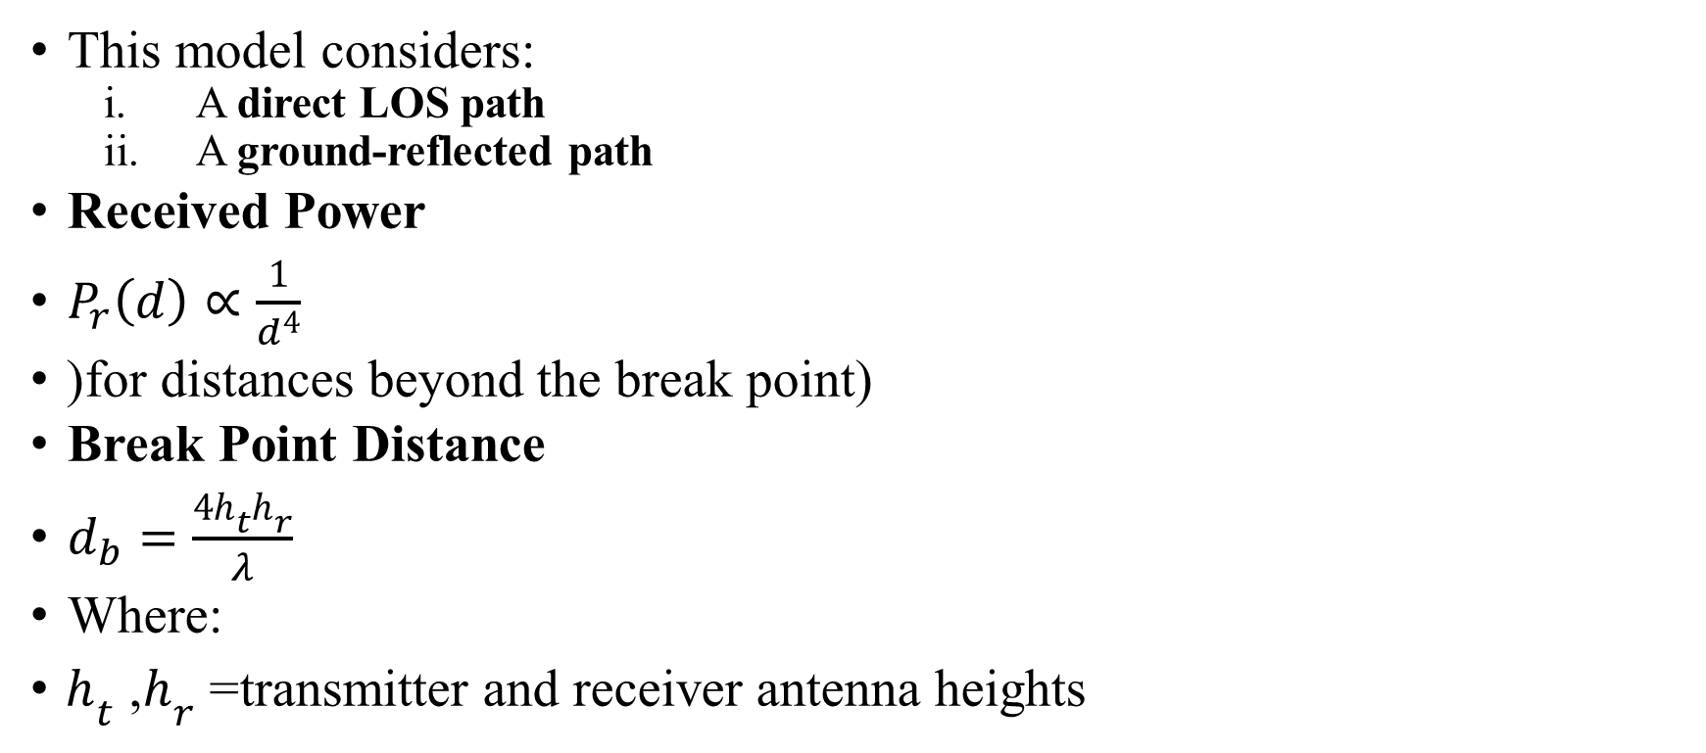
Ground Reflection (Two-Ray) Model)
This model considers:
A direct LOS path
A ground-reflected path
Received Power
$P_{r}\left(d\right)∝\frac{1}{d^{4}}$
(for distances beyond the break point)
Break Point Distance
$d_{b}=\frac{4h_{t}h_{r}}{λ}$
Where:
$h_{t}$, $h_{r}$= transmitter and receiver antenna heights

Slide 21

Example 2
Transmitter height = 30 m
Receiver height = 1.5 m
Frequency = 900 MHz
Find the breakpoint distance.
Solution
Wavelength:
$λ=\frac{3×{10}^{8}}{9×{10}^{8}}=0.333 \text{m}$
Breakpoint distance:
$d_{b}=\frac{4h_{t}h_{r}}{λ}$
$d_{b}=\frac{4\left(30\right)\left(1.5\right)}{0.333}=\boxed{540 \text{m}}$

Slide 22
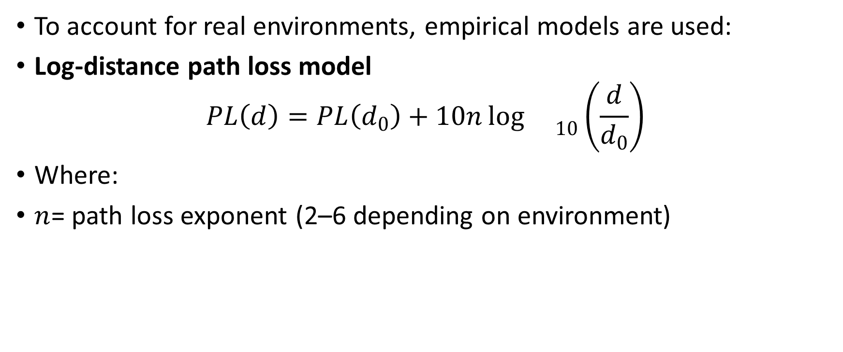
Practical Path Loss Models
To account for real environments, empirical models are used:
Log-distance path loss model
$$PL\left(d\right)=PL\left(d_{0}\right)+10n{\log{}}_{10}\left(\frac{d}{d_{0}}\right)$$
Where:
$n$= path loss exponent (2–6 depending on environment)

Slide 23
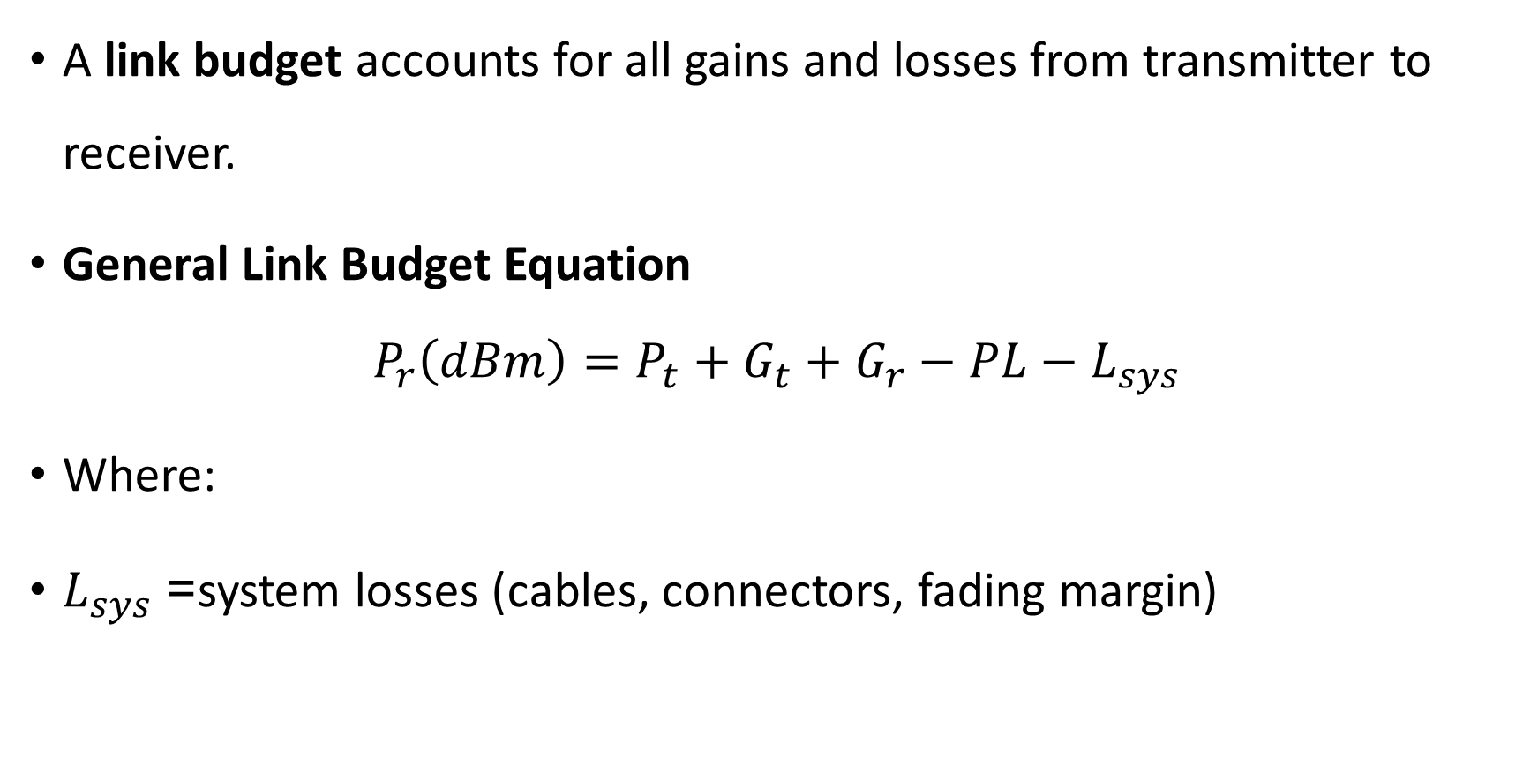
A link budget accounts for all gains and losses from transmitter to receiver.
General Link Budget Equation
$$P_{r}\left(dBm\right)=P_{t}+G_{t}+G_{r}−PL−L_{sys}$$
Where:
$L_{sys}$= system losses (cables, connectors, fading margin)

